Slide 1

LinkedIn Crawler:
The User Interface
Sprint2
Scrum At Me Bro:
Kevin Seveur
Spencer Bryant
Leah Jean-Francois
Anthony Lieu
Kevin La

Slide 2
The LinkedIn Crawler: Purpose
The LinkedIn Crawler is a collaboration project between three teams
The goal is to create a web based application that GSU students can use to locate current and former GSU students using select search criteria
LinkedIn.com will be the repository where we will query all of our searches from
We will create a desktop application utilizing JavaFX for the view component. The resulting JavaFX code is in an FXML format.

Slide 3
Projected Risks
Java RMI: We are still as a team learning about Java RMI, and need more time to implement
GUI Design: We are still working on the overall design of the GUI, and will make several concepts before we find a good look.

Slide 4
Completed Story Cards
Create SignUp page
SignUP GUI
Link SignUp page to Search Page
Build Search Page
Search page GUI
Search page CSS

Slide 5
Backlog
Research LinkedIn
Group discussion
Research Backend Communication
Java RMI
Build Search Page Logic: Send Query to backend
Java RMI

Slide 6
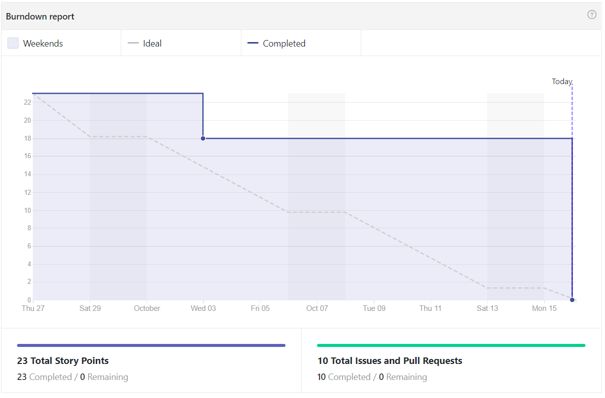
Burndown Chart

Slide 7
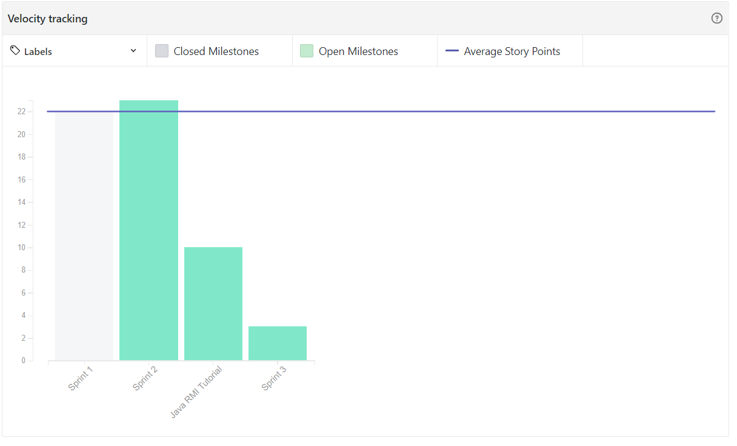
Velocity Chart

Slide 8
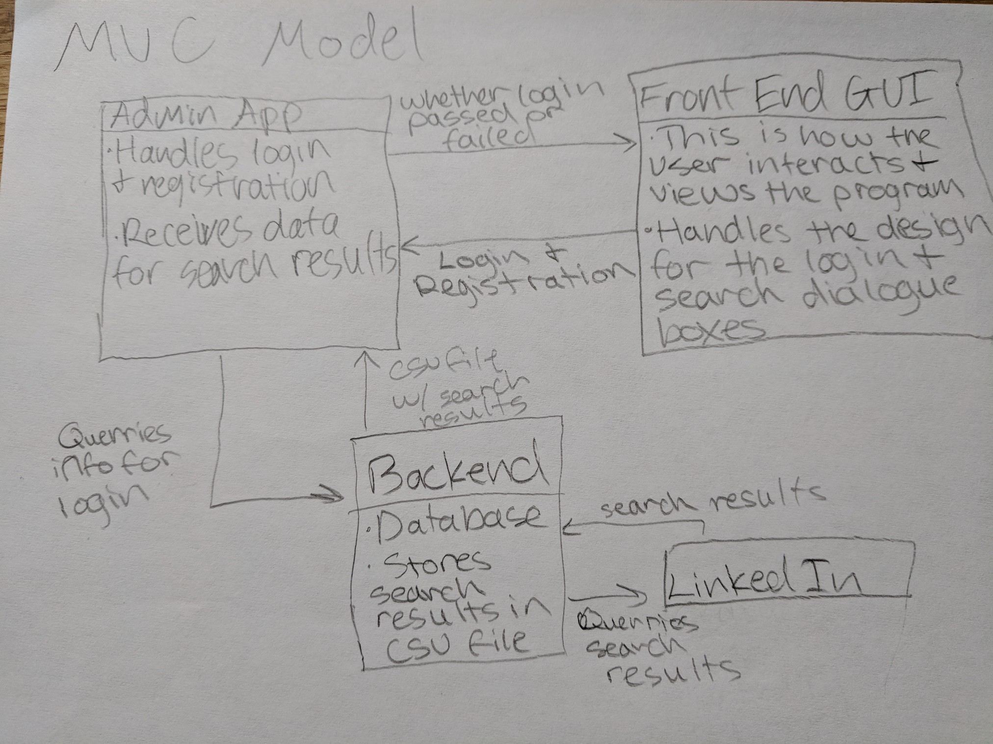
Architecture Design Pattern
Search criteria

Slide 9
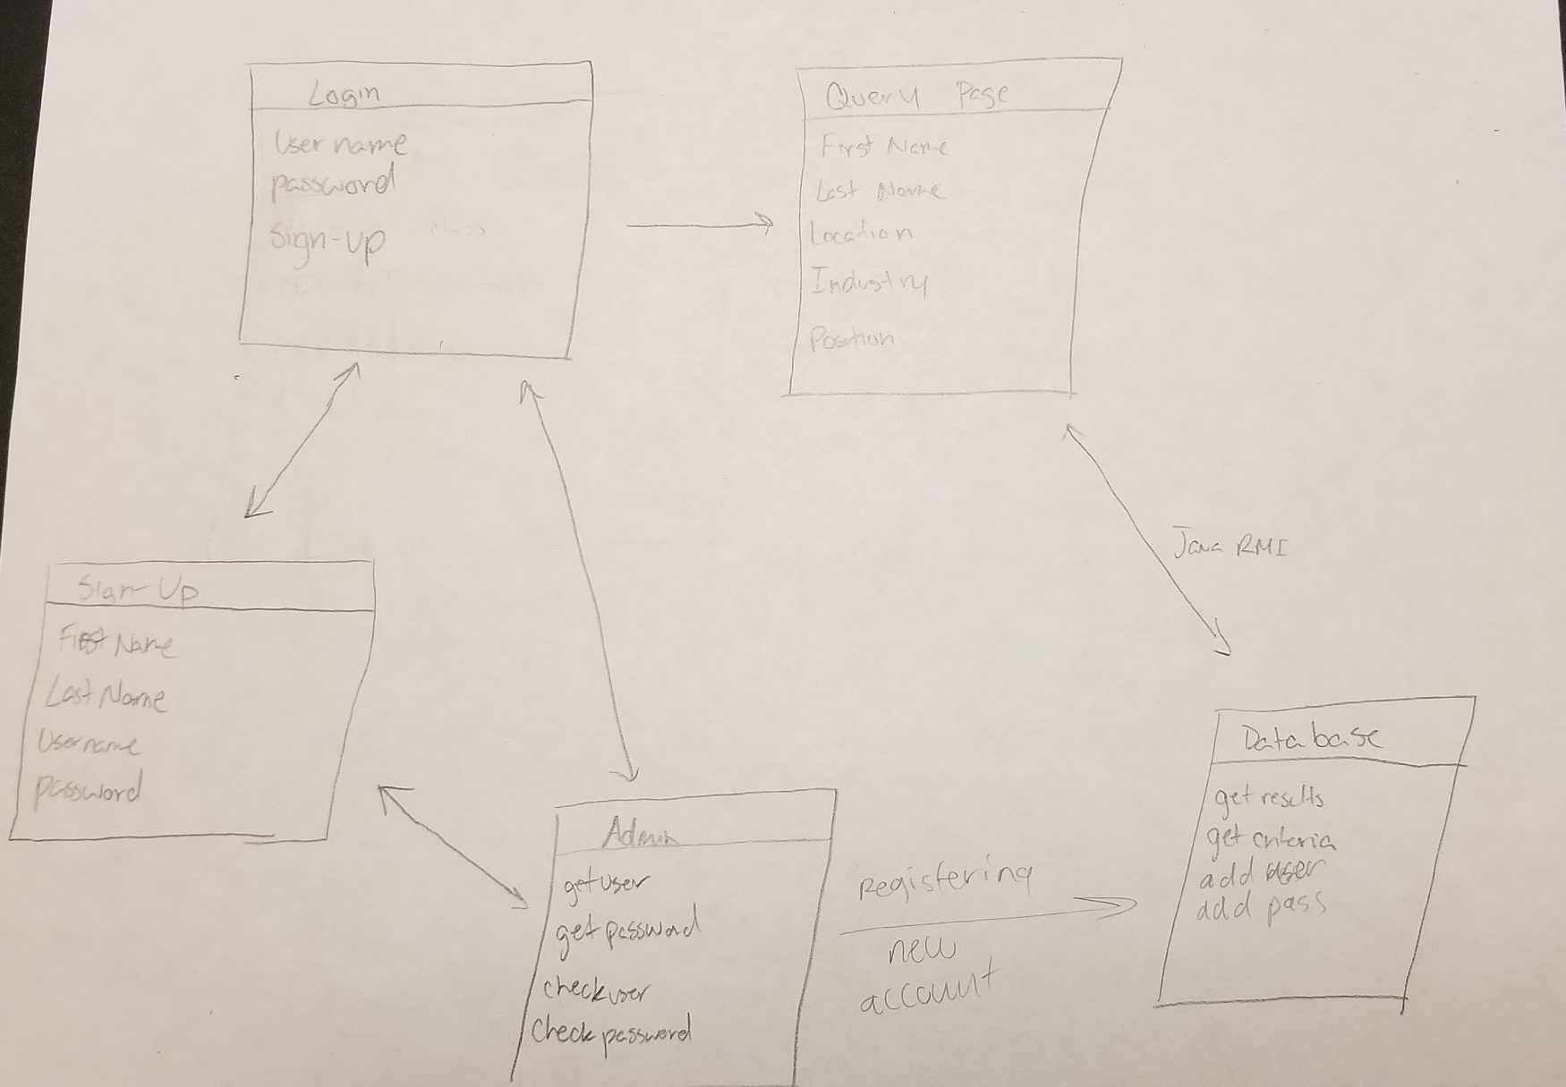
Interface Model

